Slide 1
Encryption and BitCoin
“Unlocking the future: Exploring the world of bitcoin & cryptocurrency

Slide 2
Key Takeaways:
Public-key cryptography VS traditional symmetric-key cryptography.
Generation of public and private keys. Encryption and decryption of data.
Digital signatures and authenticity of data.
Public-private key encryption and Bitcoin wallets for Bitcoin transactions.
Types of BitCoin Wallets: Hot & Cold Wallets, their advantages and disadvantages
Securing BitCoin Wallets. Backing up private keys using multi-factor authentication.

Slide 3
01
Asymmetric Cryptography
Alice(sender) and bob(recipient) possess two keys: public and private each

Slide 4
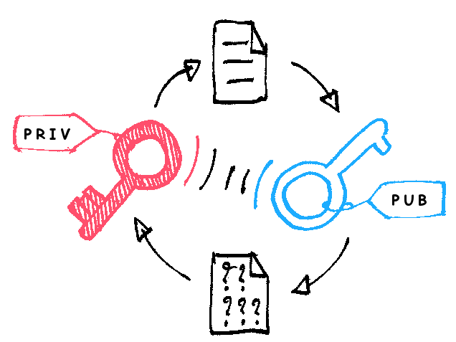
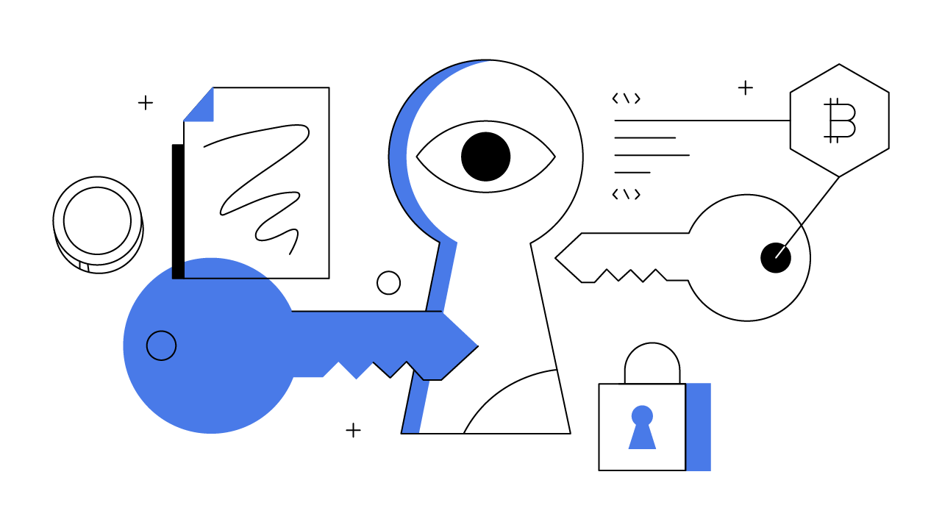
The Key-Pairs
Public Key:
Unique, openly shared cryptographic key
Used for encrypting data/messages
Validates digital signatures
Generates public addresses in cryptocurrencies
Private Key:
Secret, known only to owner
Paired with a public key
Decrypts data/messages
Authorizes transactions in cryptocurrencies
Must be securely stored for asset control

Slide 5
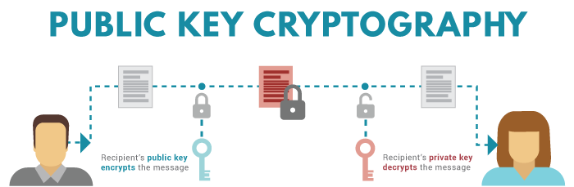
Uses pairs of keys: public and private keys
Public key is freely shared, private key is kept secret
Public key encrypts data, private key decrypts data
Provides secure communication without needing to share secret keys
Used for digital signatures, authentication, and encryption in secure communication protocols

Slide 6
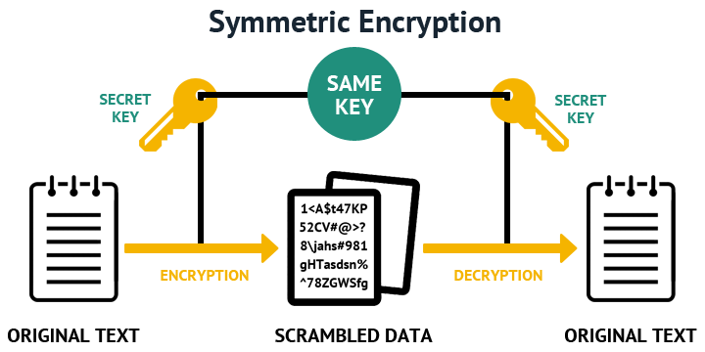
Utilizes a single shared key for both encryption and decryption
Key must remain confidential between communicating parties
Fast and efficient encryption process
Ideal for encrypting large volumes of data
Vulnerable to key distribution and management challenges

Slide 7
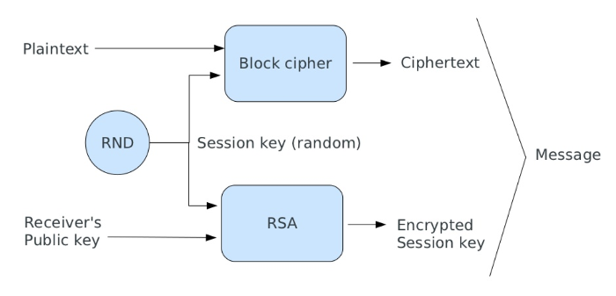
Hybrid Encryption
Sender creates a random symmetric key to encrypt the message.
Message is encrypted with the symmetric key.
Symmetric key is encrypted with receiver's public key.
Encrypted message and symmetric key are sent to receiver.
Receiver decrypts symmetric key with private key.
Message is decrypted with symmetric key, revealing the original content.

Slide 8

The Math: RSA Algorithm
RSA Keys:
Public Key: (e, N) - Made public, used for encryption.
Private Key: (d, N) - Kept secret, used for decryption.
Key Generation:
Choose 2 large, distinct prime numbers (p & q).
N = p x q (modulus for both keys).
φ(N) = (p - 1) x (q - 1) (Euler's Totient).
Choose public exponent (e): 1 < e < φ(N), relatively prime to φ(N).
Find private exponent (d): e * d ≡ 1 (mod φ(N)) (often using Extended Euclidean Algorithm).
Encryption:
C = m^e mod N (message raised to public exponent modulo N).
Decryption:
m = C^d mod N (encrypted message raised to private exponent modulo N).

Slide 9
BitCoin & Wallets

Slide 10


Slide 11
BitCoin
Each Bitcoin wallet has a unique key pair:
Private Key: Secret code for accessing and spending bitcoin.
Public Key: Shareable address for receiving bitcoin.
When sending bitcoin:
Specify recipient's public key (Bitcoin address).
Sign transaction with your private key.
Broadcast transaction to Bitcoin network.
Miners verify transaction:
Use recipient's public key to validate signature.
Only owner of private key could authorize transaction.
Public key encryption:
Transaction details visible to all but encrypted.
Recipient's private key required to access funds.

Slide 12
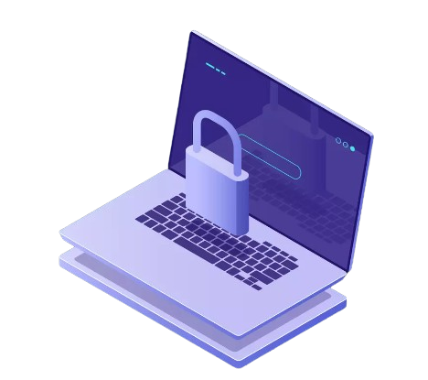
Bitcoin:
Digital currency, not controlled by any bank or government.
Relies on a decentralized network of computers to verify transactions.
Units are called bitcoins (BTC) and can be divided into smaller units (mBTC, μBTC).
Bitcoin Wallets:
Don't actually store bitcoins, they store cryptographic keys.
These keys allow you to:
Send and receive bitcoins.
Keep track of your bitcoin balance.
Different types of wallets offer varying levels of security and functionality:
Software(Hot) wallets: Convenient, can be on your phone or computer, but can be vulnerable to hacks.
Hardware(Cold) wallets: More secure, store keys offline on a physical device, but less convenient.

Slide 13
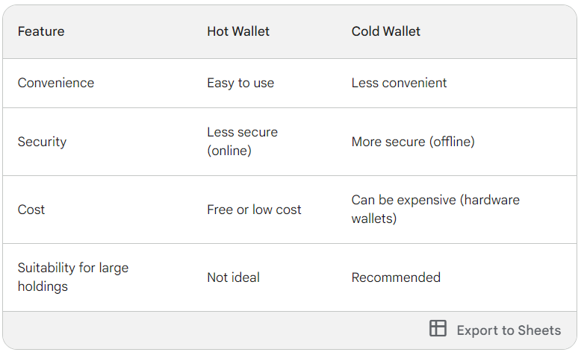

Slide 14
Backup Private Keys: This is crucial! Treat them like your bank password and store backups securely offline (consider paper or hardware wallets).
Use Multi-Factor Auth (MFA): Adds an extra verification step for logins and transactions (like a code from your phone).
Choose Reputable Wallets: Research security practices before picking a wallet provider.
Update Software: Keep your wallet app and device firmware up-to-date.
Beware Phishing: Don't click suspicious links or enter private keys on untrusted websites.
Strong Passwords: Use unique, complex passwords everywhere you access your Bitcoin.
Secure Devices: Keep your devices with antivirus protection and avoid public Wi-Fi for wallet access.

Slide 15
THANK YOU
Do you have any questions?

Slide 16
ALTERNATIVE RESOURCES
Symmetric-Key Cryptography Basics of Public-Private Key Encryption RSA (advanced) Bitcoin Wallet More on Wallets Bitcoin Core Github

